Slide 1


Effects
History
Benefits
Conclusion
Objective
Location

Slide 2
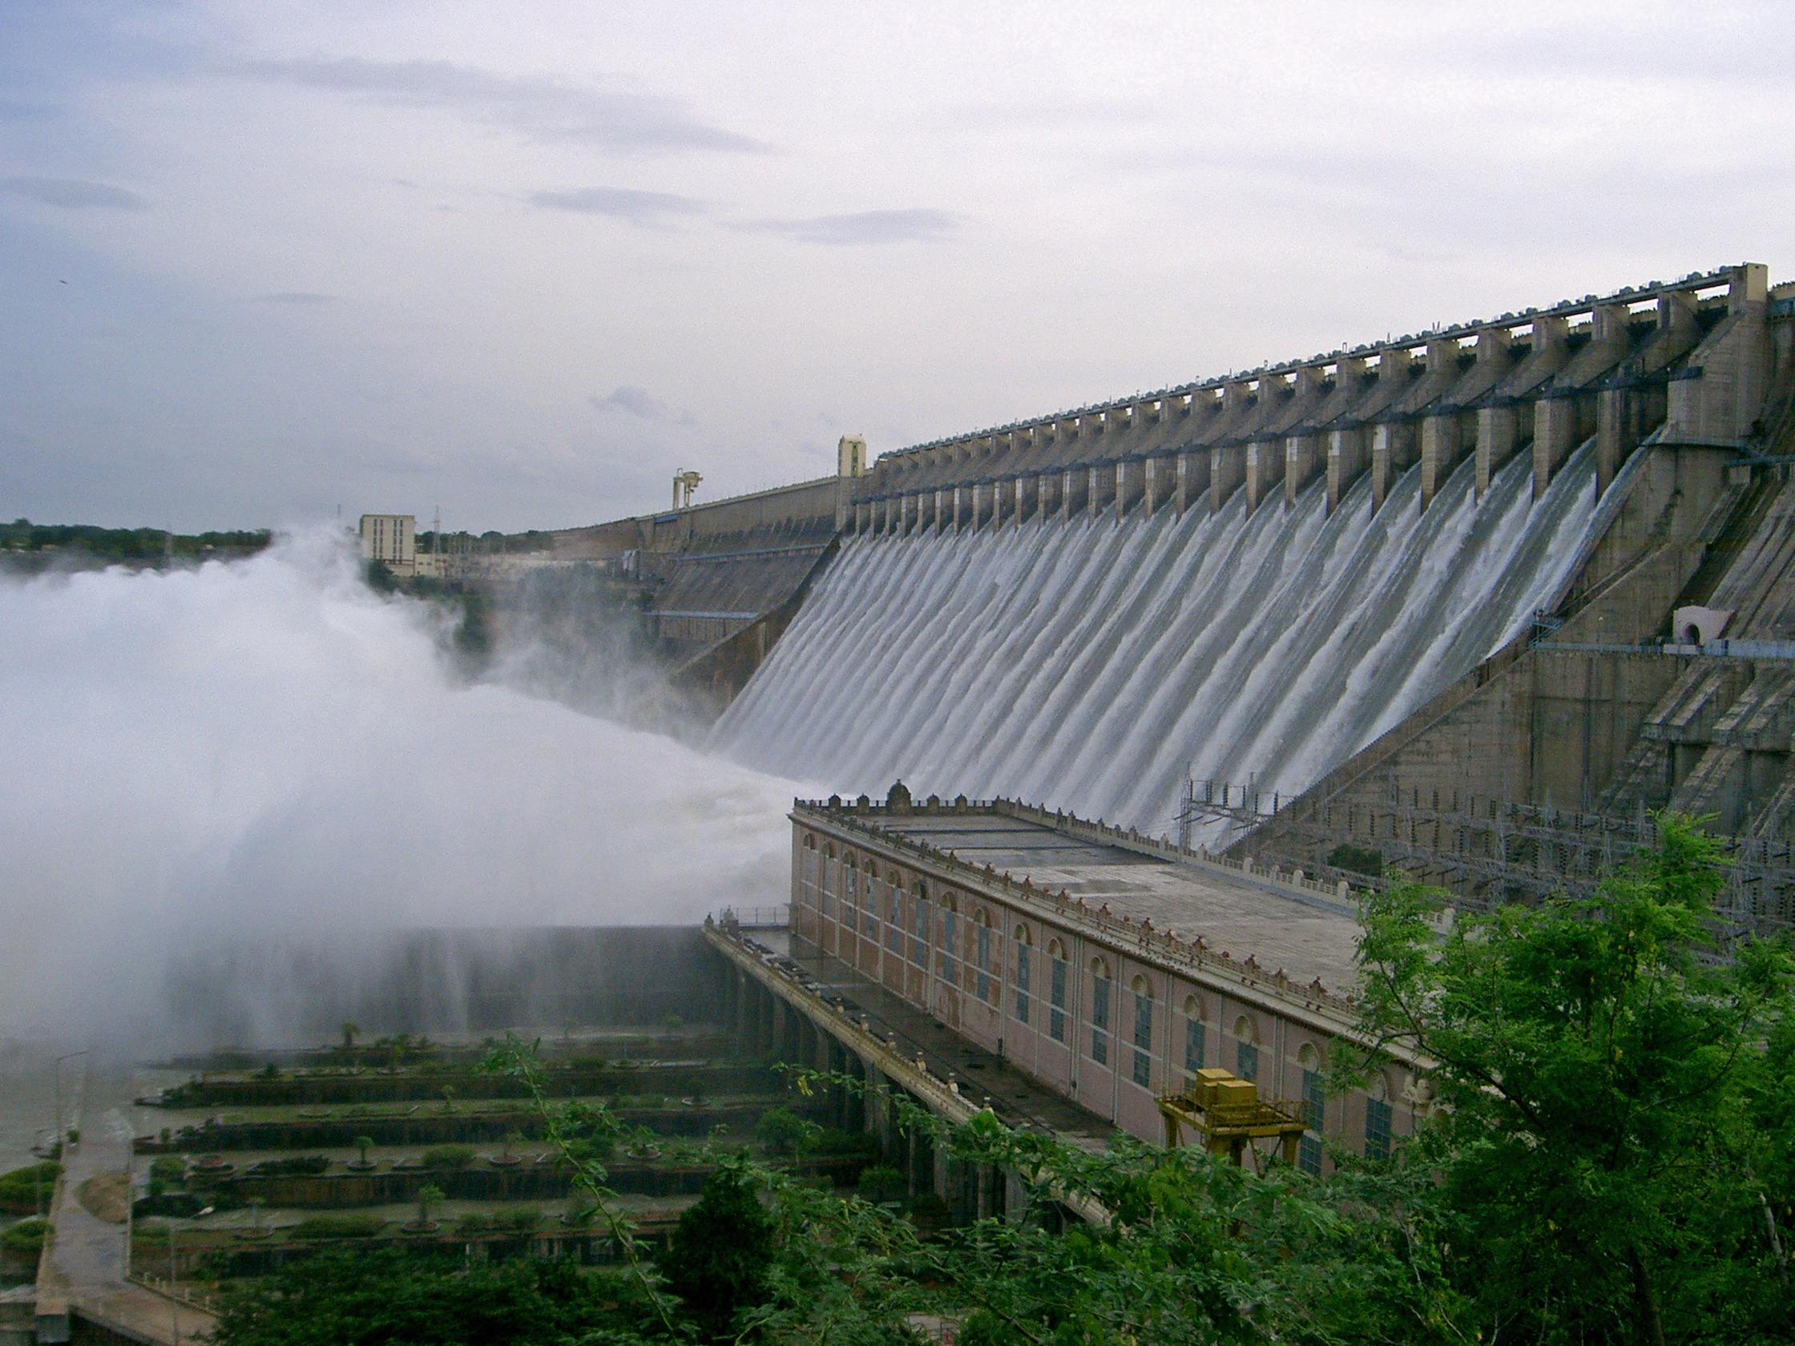
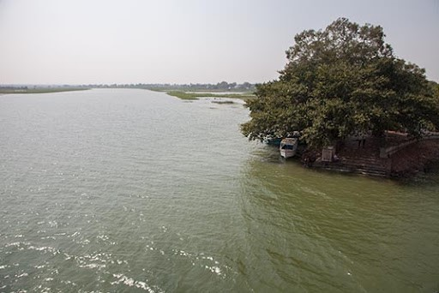
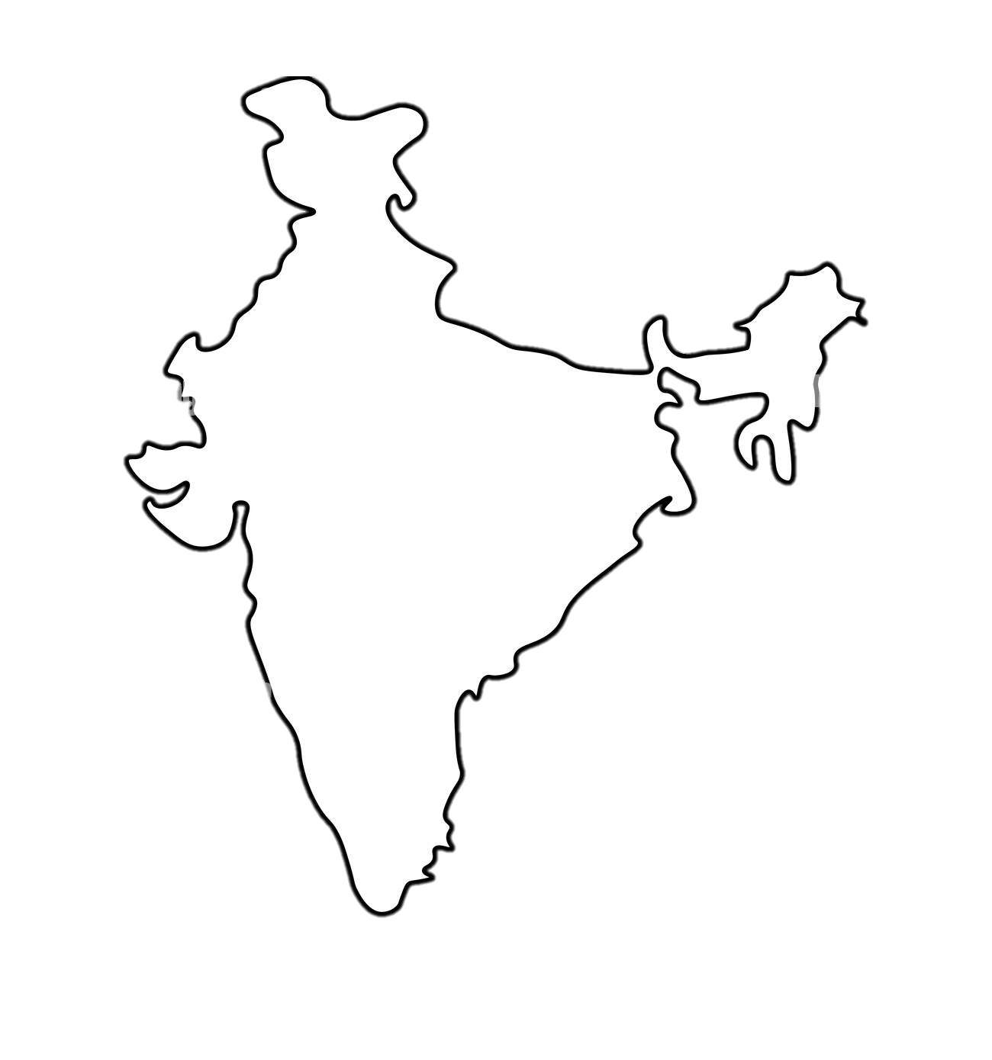

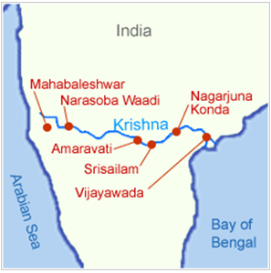

7
7
Benefits
History
Effects
Objective
Location
Conclusion
Nagarjuna Sagar

Slide 3
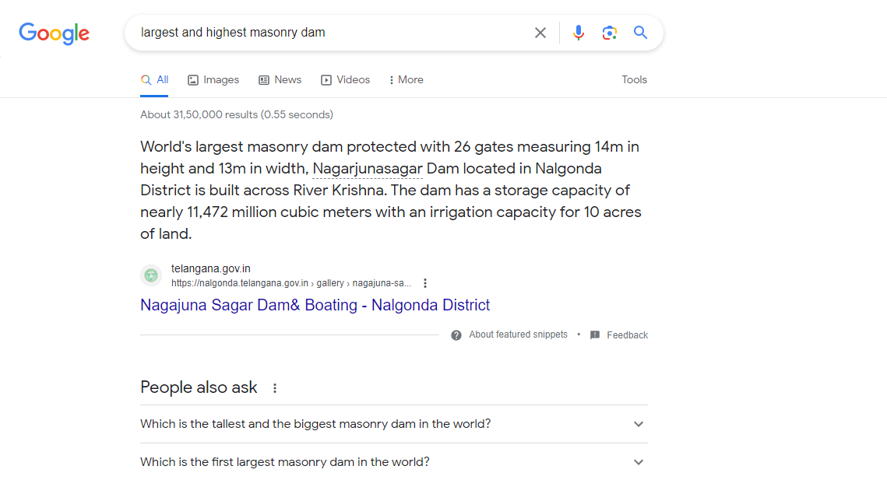


Gmail
Images
Largest and highest masonry dam

Slide 4
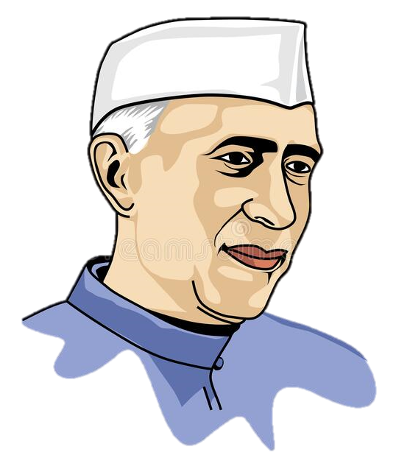
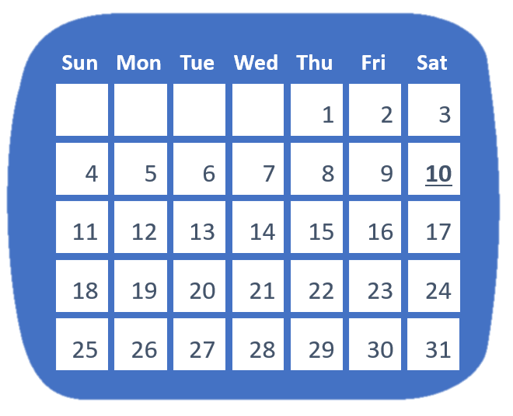
10th DEC 1955
Effects
History
Benefits
Conclusion
Objective
Location
Inaugurated by Jawaharlal Nehru

Slide 5
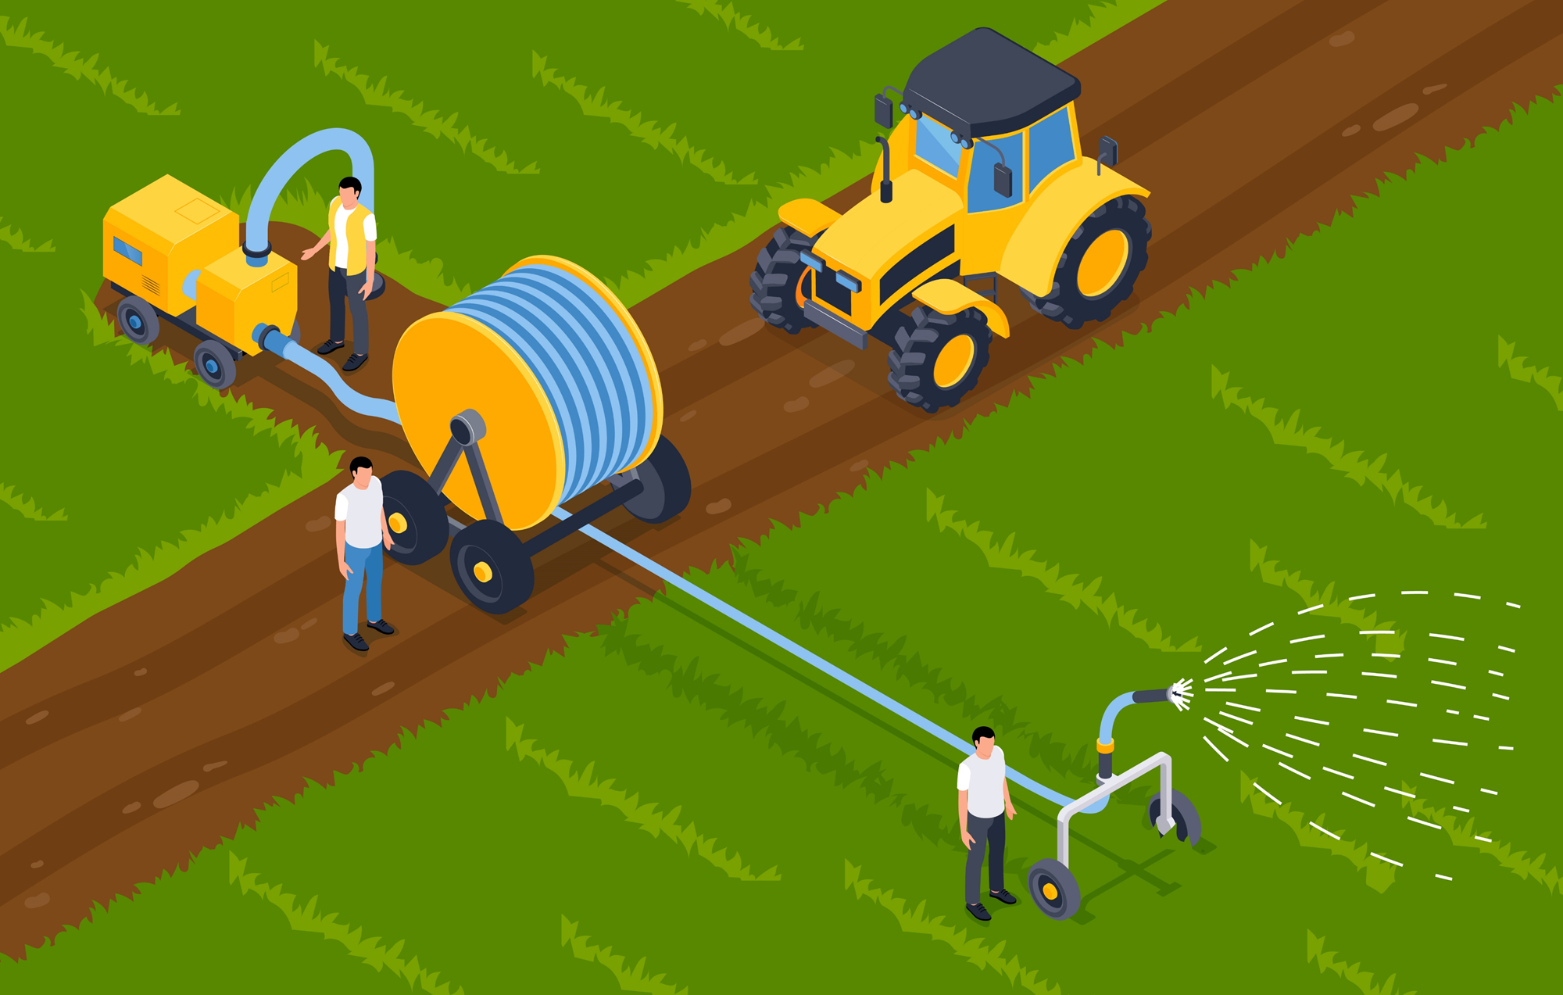


Effects
History
Benefits
Objective
Location
Conclusion
IRRIGATION
HYDRO ELECTRICITY
To improve irrigation service so as to increase productivity of irrigated agriculture
generates electricity through hydroelectricity, and has 8 hydroelectric power units

Slide 6


01
02
IRRIGATION WATER
Increased farming income
The dam provides irrigation water along with electricity generation
increase of about 300% in the farm income and Crop yields increased
03
history
Effects
Benefits
Conclusion
Objective
Location
RECREATION
recreational benefits such as boating, swimming, fishing

Slide 7

01
05
Displacement of people- 55,000 people were relocated
Aquatic population -completely depopulated
Effects
History
Benefits
Conclusion
DISADVANTAGES
Objective
Location
02
04
Caused erosion and contaminated its groundwater supply
Created long-term ecological issues to the health of the delta lands
03
Land salination and sea encroachment of coastal lands

Slide 8
50 million people displaced in 50 years
People lost their lives during the construction
Conclusion
History
Effects
Benefits
Objective
Location
45000 to 70,000 got employment opportunities

Slide 9


